Slide 1

Feature-Based
Airbnb Price Prediction
GeekHub
Brian Mike Tony Logan

Slide 2
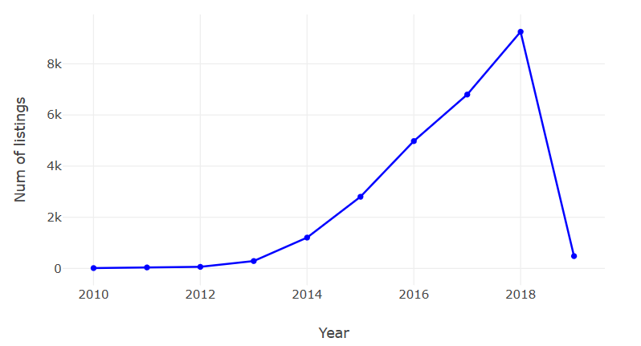
Inspiration
Inspiration · Problem Statement · Feature & Data Engineering · Model Building · Evaluation
Since ... Short-time leasing becomes a trendy lifestyle for nowadays’ generation.
As a result … Airbnb has a booming market in Beijing with increasing joiners.
But … New hosts often have a hard time on properly pricing their property

Slide 3
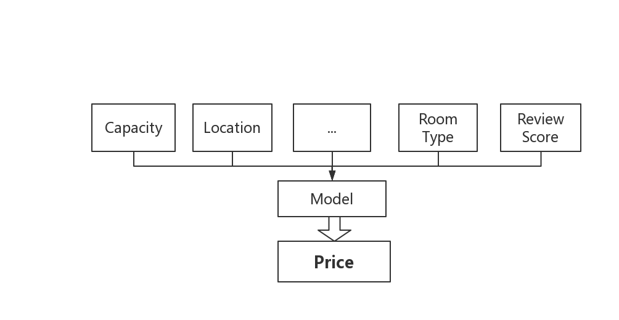
Problem Statement
Inspiration · Problem Statement · Feature & Data Engineering · Model Building · Evaluation
Given a series of data describes the property’s features
Output the reasonable/best price point for the host.

Slide 4
Inspiration · Problem Statement · Feature & Data Engineering · Model Building · Evaluation
Data Pre-Processing
Drop Properties with no reviews (i.e. No people rent it/pay the price yet)
Drop Properties that lacks to many features ( less than 100 rows of them )
Drop outliers handpicked via inspection (i.e. Check the Actual id on www.airbnb.com )
Drop Properties with unreasonable prices (i.e. the host didn’t actually want to Airbnb it )
[ price < (50 * accomondates) OR (50 * beds) ]
[ Price > 20,000 OR price = 9999 ]
[ beds=50 OR bathrooms=101 OR min_nights > 3 ]
Fill up a few fixable nulls.

Slide 5
Feature Engineering
Inspiration · Problem Statement · Feature & Data Engineering · Model Building · Evaluation
Feature Selection - Drop features we’re uncapable to deal with or irrelevant
All words | Irrelevant | Missing values
Summary Abstract | The landlord ID Host since | Weekly price Square feet
e.g. The neighborhood has a … | e.g. 192875 e.g. 527062 | All none
One-hot Encoding - Transform categorical features into numerical features.
Feature Generating - Adding new features ( Transform coordinates to distances )

Slide 6
Inspiration · Problem Statement · Feature & Data Engineering · Model Building · Evaluation
Scores
Model
Splitted Data
PIPELINE
Visuals

Slide 7
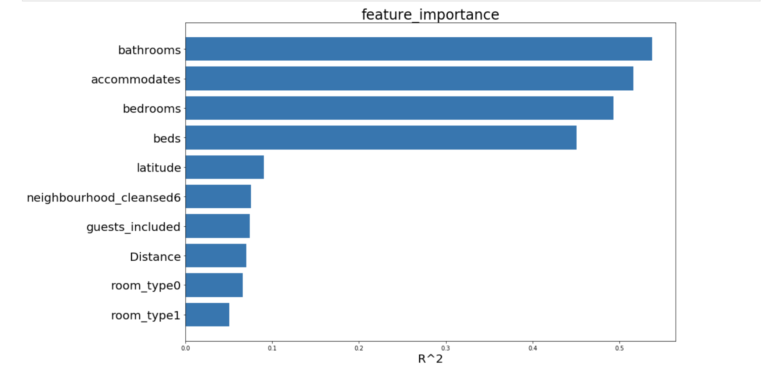
Inspiration · Problem Statement · Feature & Data Engineering · Model Building · Evaluation

Slide 8
Inspiration · Problem Statement · Feature & Data Engineering · Model Building · Evaluation
Model Name | R^2 Score | MSE
GradientBoostingRegressor | 0.7309 | 93735.296
RandomForestRegressor | 0.7005 | 104310.6571
BaggingRegressor (base on decision tree) | 0.6625 | 117552.8415
NerualNetwork | 0.6220 | 127463.1387

Slide 9
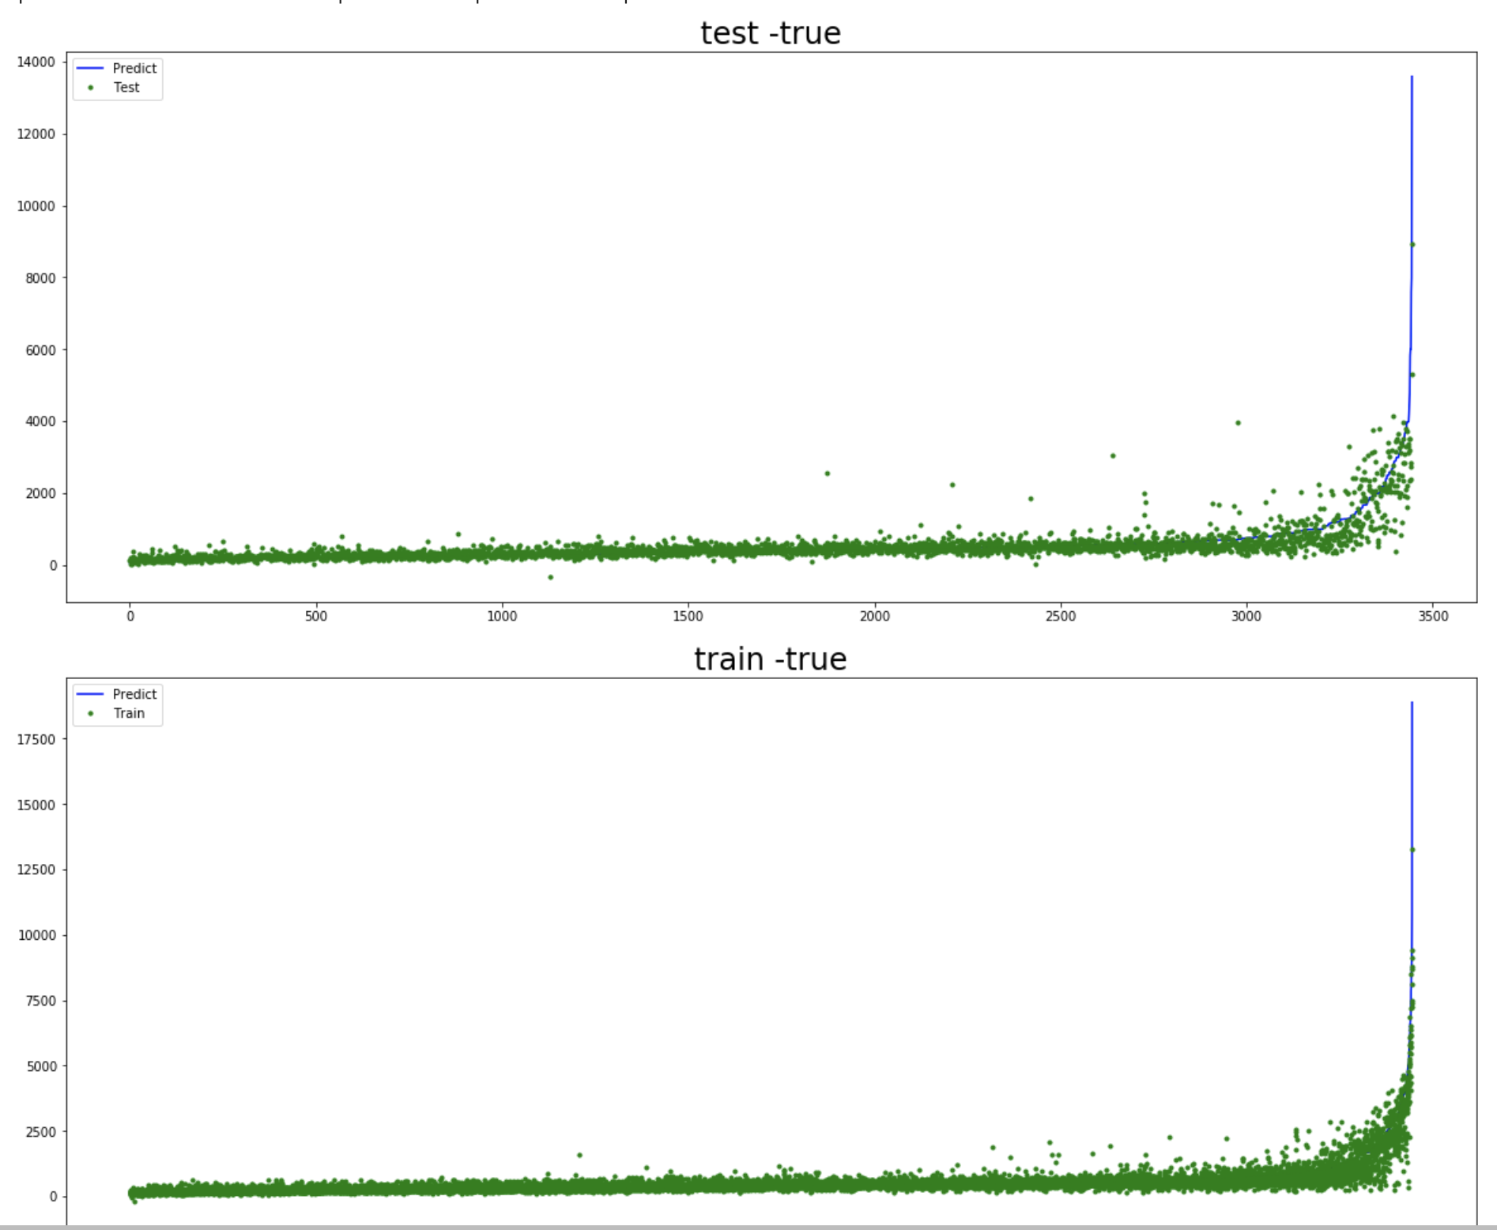
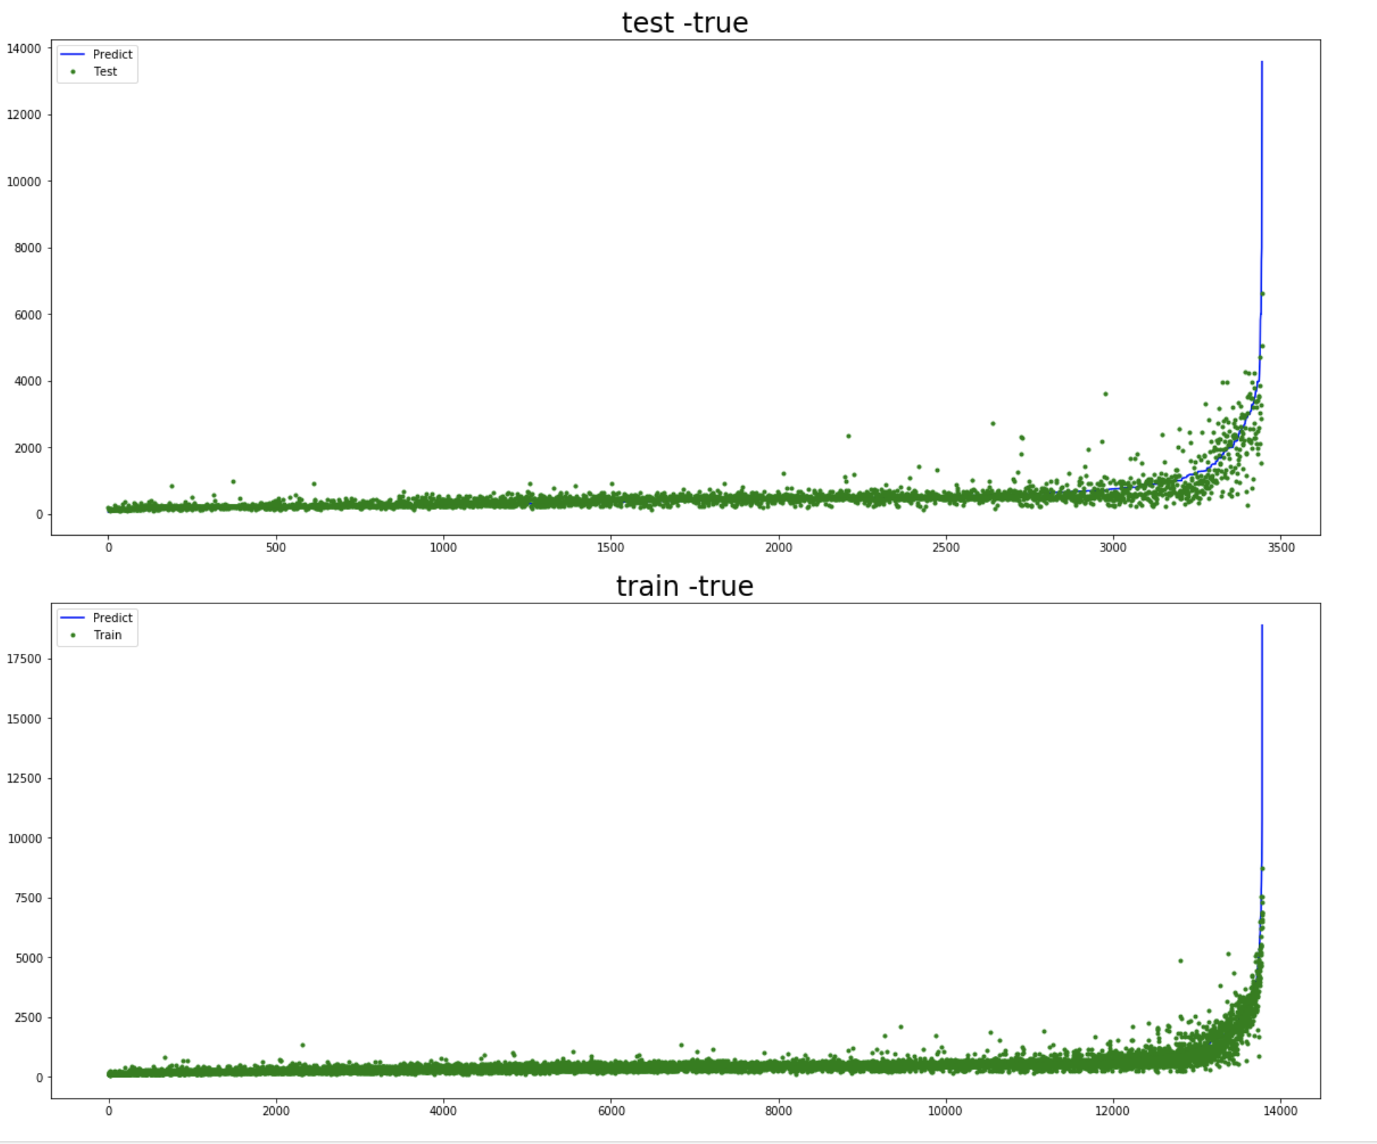
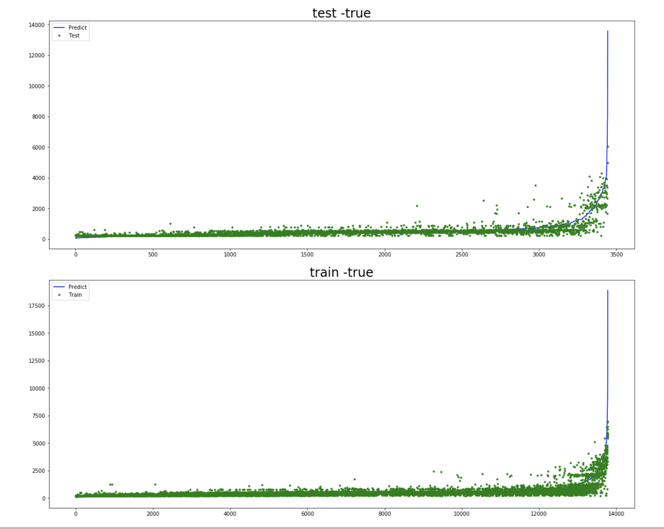
Inspiration · Problem Statement · Feature & Data Engineering · Model Building · Evaluation
BaggingRegressor
(base on decision tree)
GradientBoostingRegressor
RandomForestRegressor

Slide 10
Thank you!

